Slide 1

BankBot AI Chatbot for Banking FAQs

Slide 2
Introduction
Customers often have recurring banking queries related to account balance, interest rates, loan eligibility, transaction status, branch details, etc.
Relying on manual customer service teams leads to delays and high operational costs.
This project aims to build an intelligent chatbot that can handle these questions through natural conversations.
It will support both rule-based and machine learning approaches to ensure accuracy and scalability.
The chatbot will be accessible via a web interface and possibly integrated into mobile apps .

Slide 3
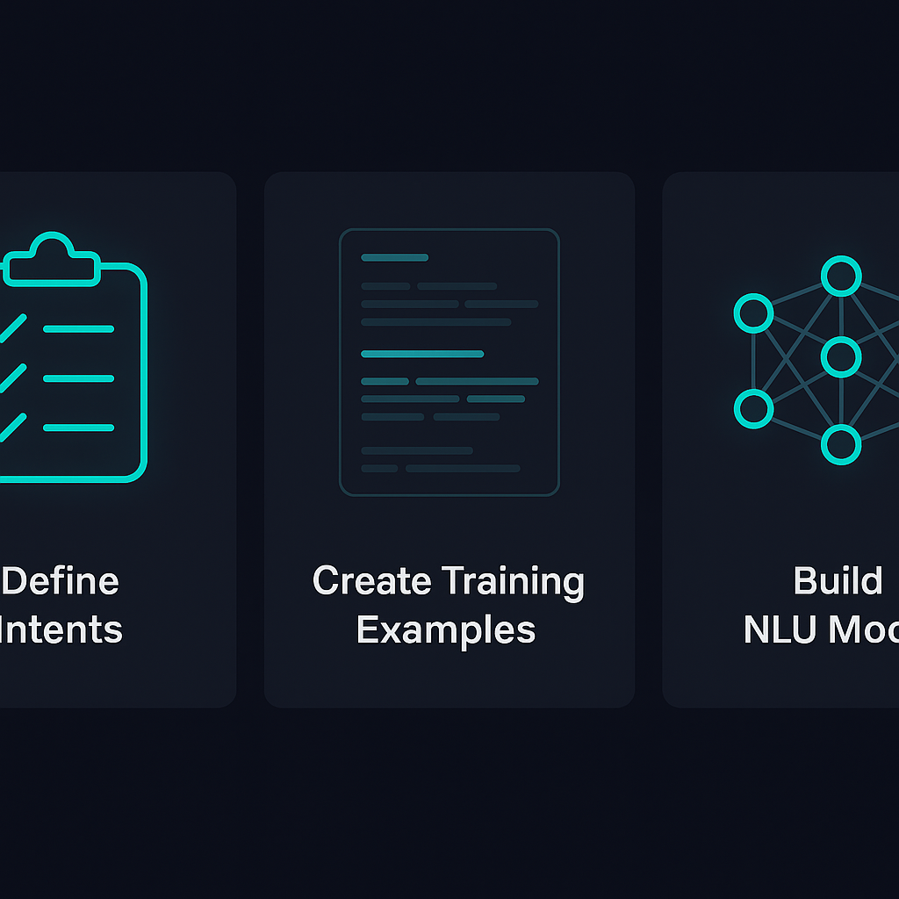
Milestone 1: Intent Recognition
Key Steps for Understanding Users
Define Intents
Check Balance
Apply for Loan
Block Card
Transaction Status
Create Training Examples
Multiple training examples improve chatbot learning.
Helps recognize different user inputs for each banking intent.
Increases accuracy in identifying banking-related queries.
Build NLU Model
spaCy improve accuracy.
the user’s intent
important entities like account number, amount, card type

Slide 4
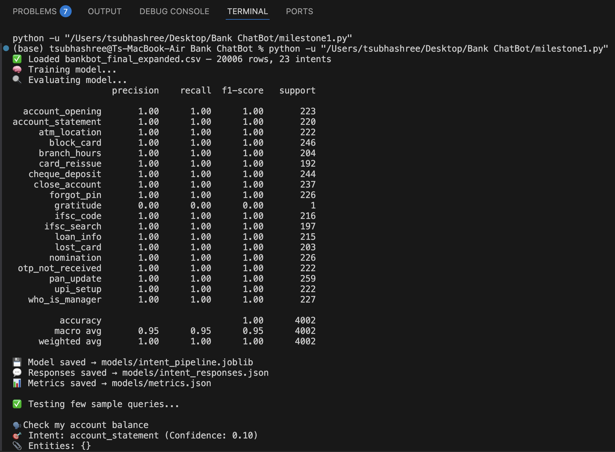
Milestone 1: Intent Recognition

Slide 5
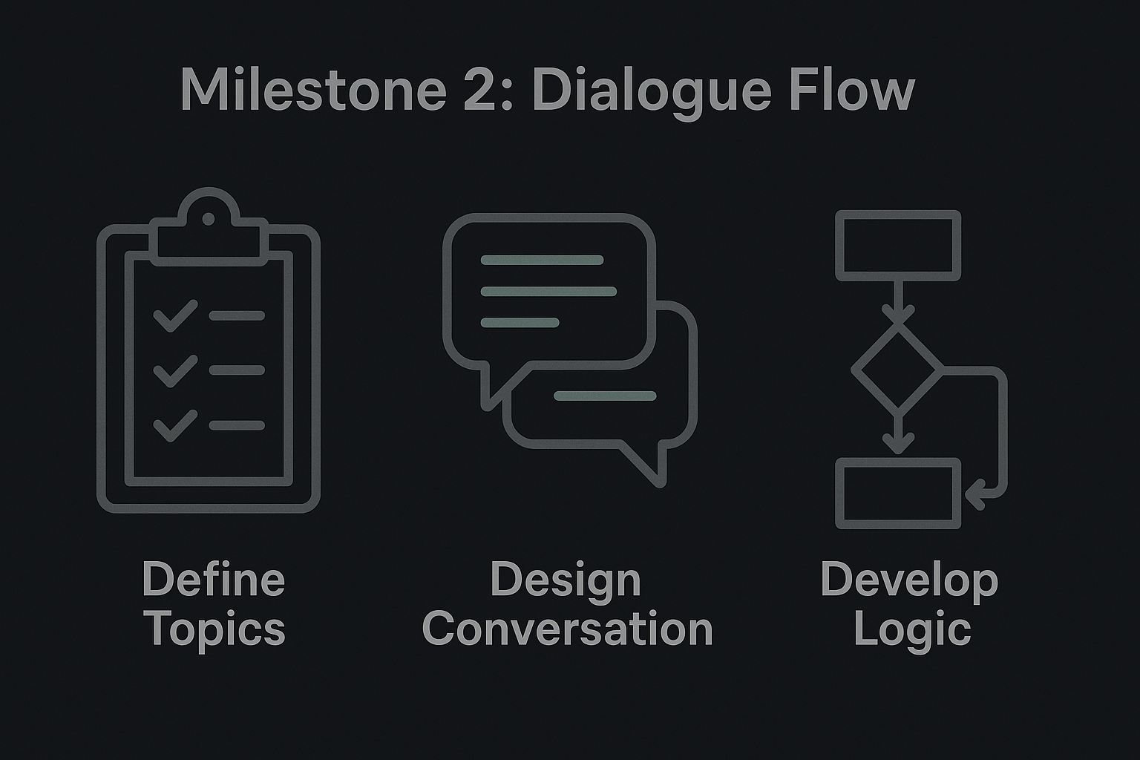
Milestone 2 : Dialogue Flow
Flow
Define structured conversation paths
ChitChat
Enable casual user interactions
Fallback
Handle unclear user queries
Tracking
Maintain dialogue context awareness

Slide 6
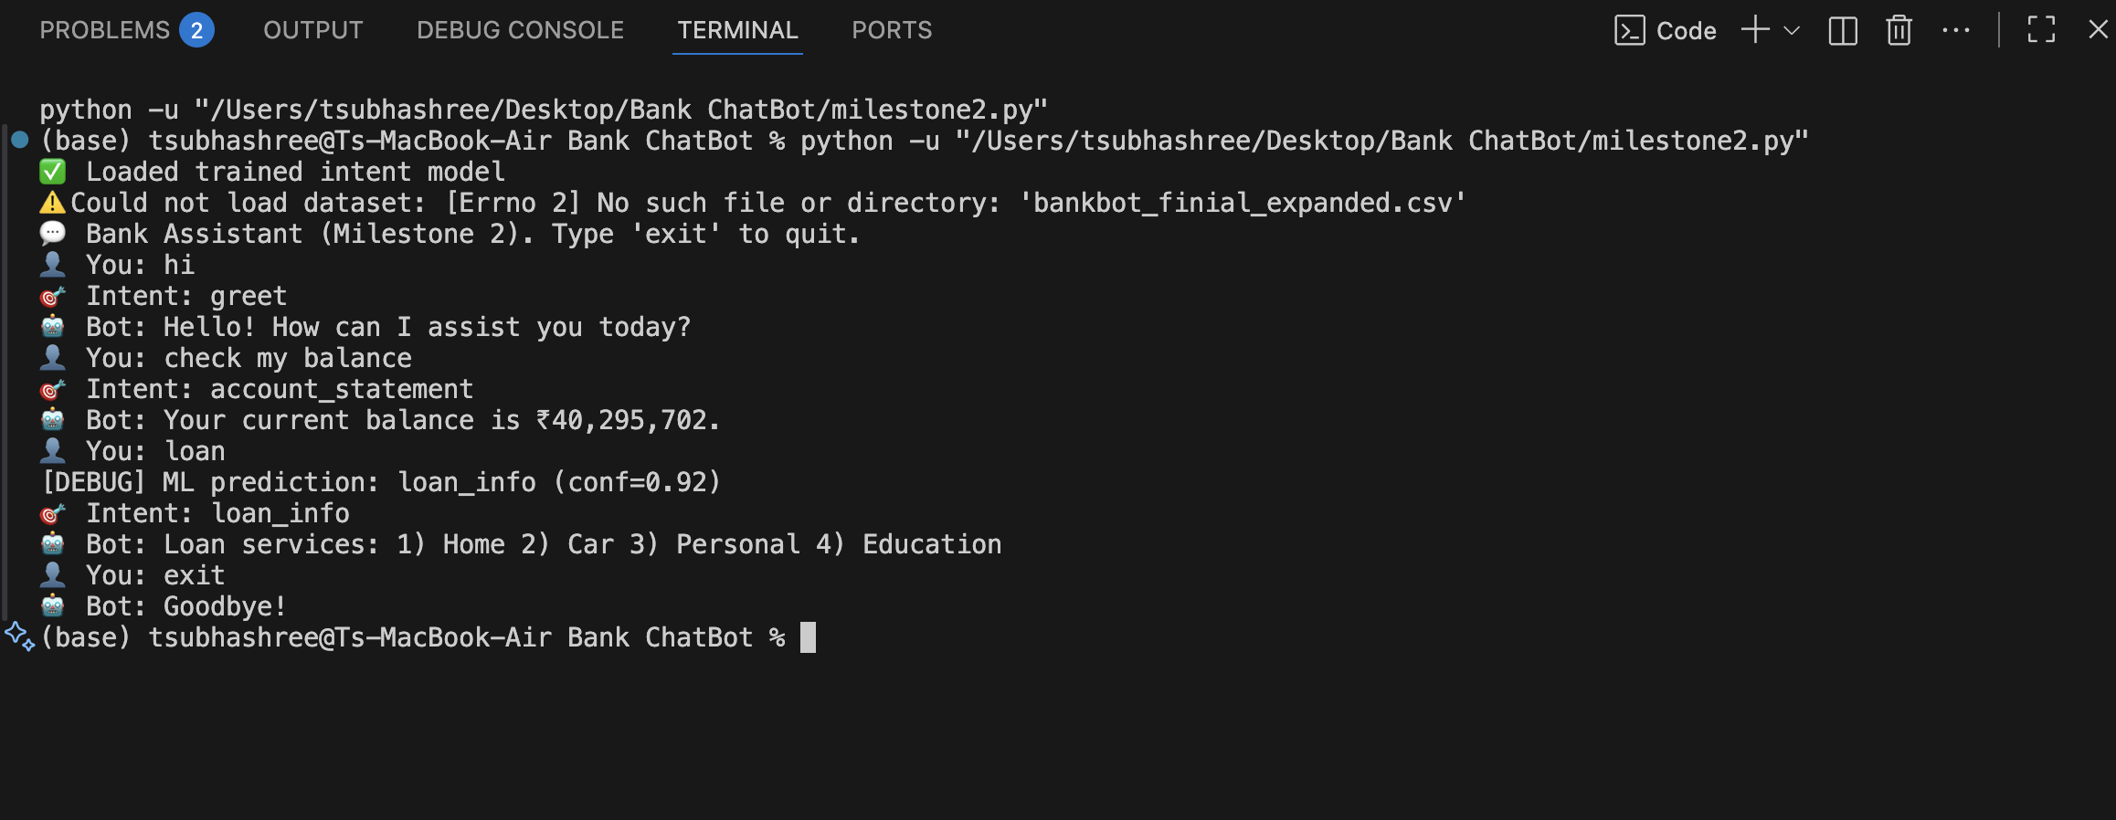
Milestone 2 : Dialogue Flow

Slide 7
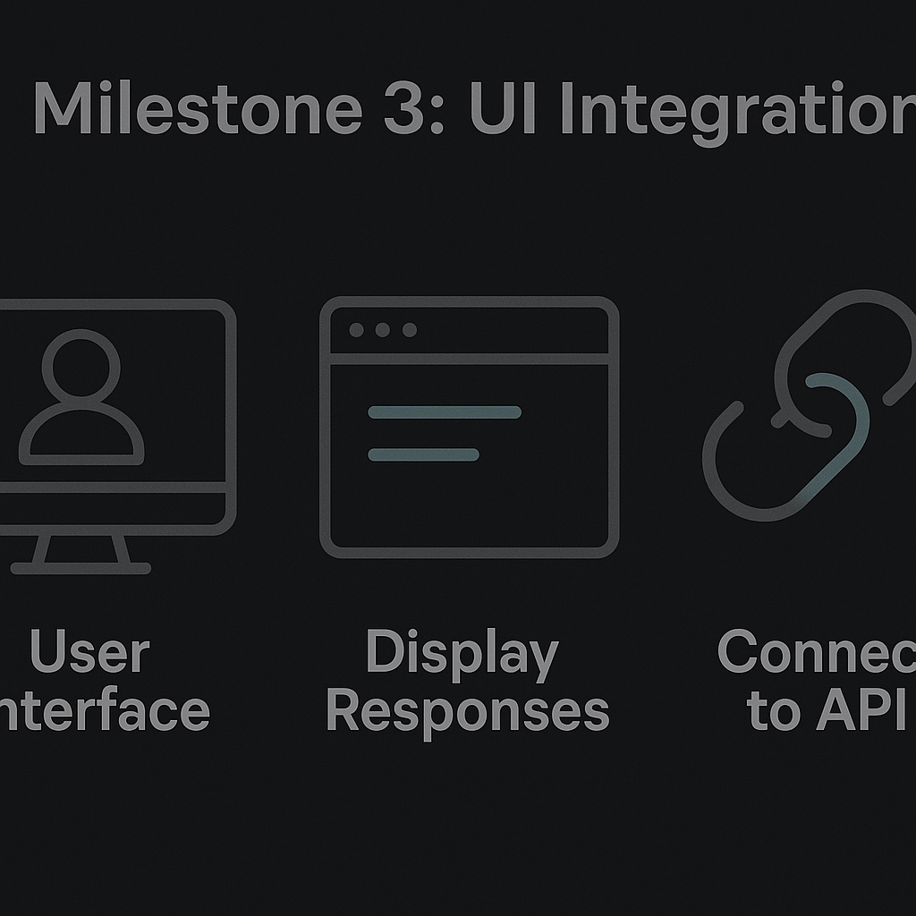
Milestone 3 : UI Integration
Key aspects of user interaction
Develop Interface
Web-based chat interface enables user interaction.
Built using frameworks like Flask or React.
Ensures a smooth and engaging user experience.
Connect Frontend
real-time communication
instant responses
a clean chat experience

Slide 8
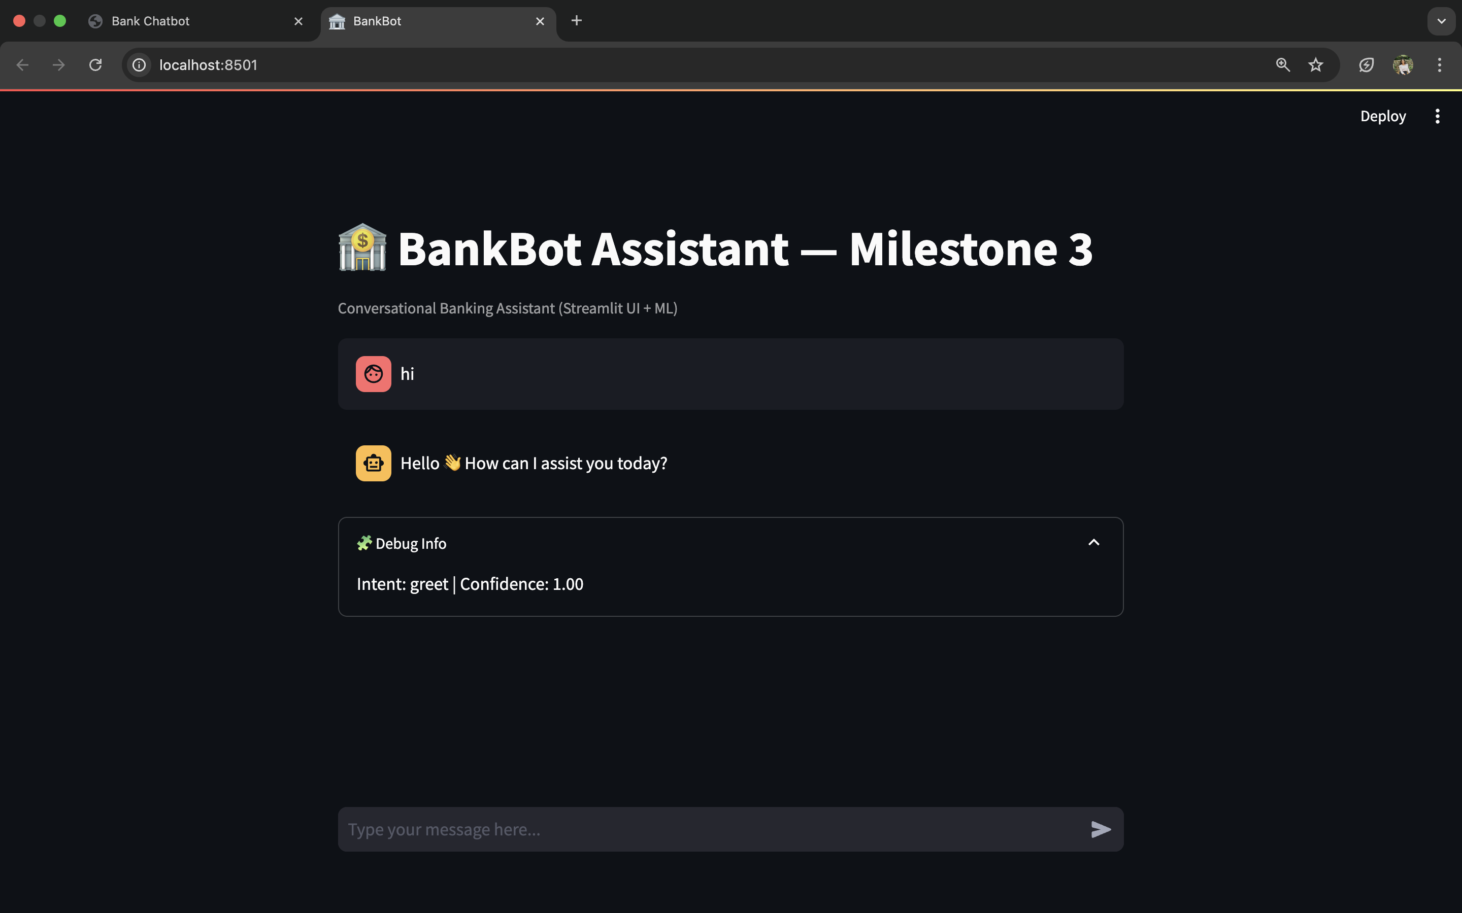
Milestone 3 : UI Integration

Slide 9
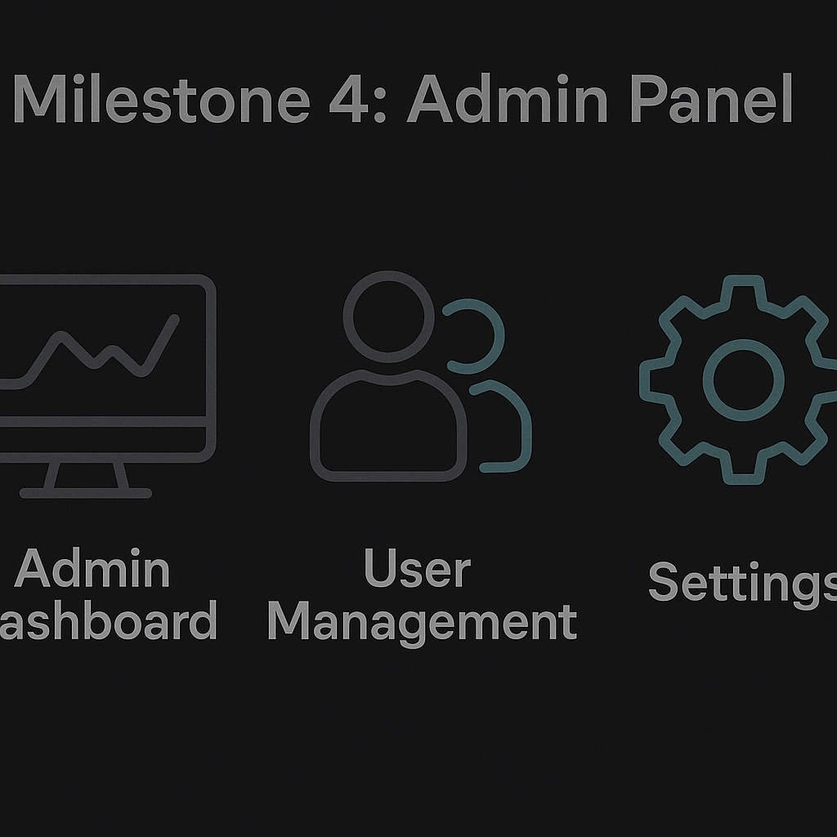
Milestone 4 : Admin Panel
Essential tools for chatbot management
Edit Training Data
Admin panel allows easy training data updates.
Supports continuous chatbot improvement.
Enhances understanding and responsiveness.
View User Queries
Admins can monitor user queries for insights.
Supports data-driven decision-making.
Improves chatbot effectiveness and user satisfaction.
Trigger Model Retraining
Panel allows triggering model retraining.
Keeps chatbot updated with evolving user intents.
Improves response accuracy and relevance.

Slide 10
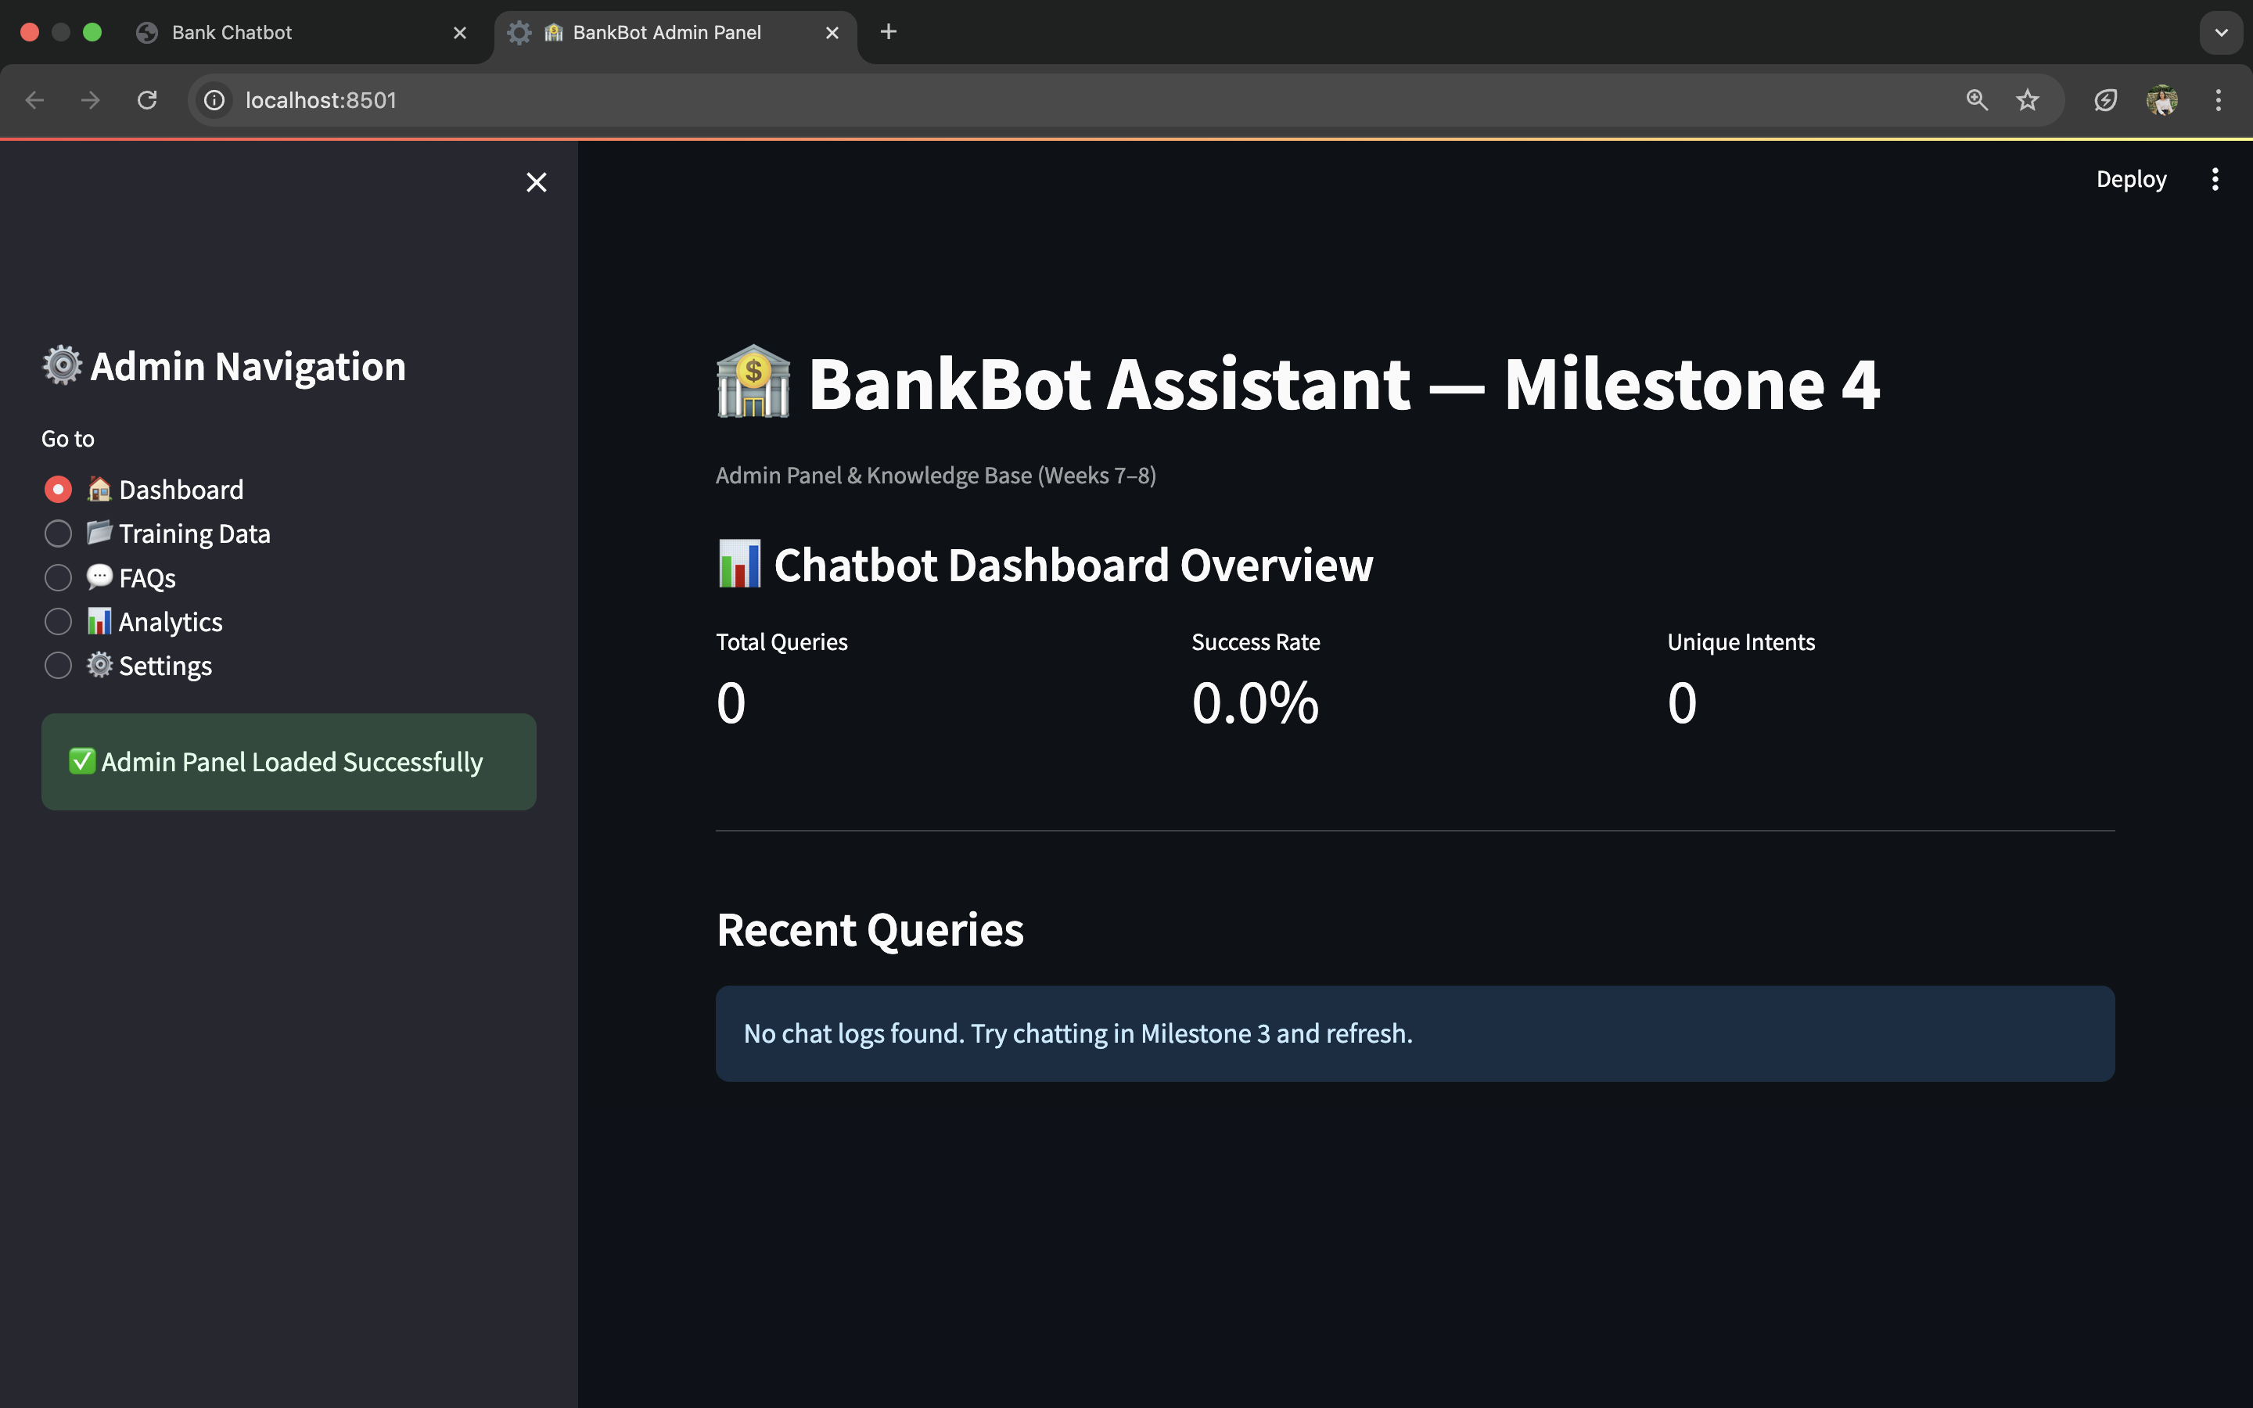
Milestone 4 : Admin Panel

Slide 11
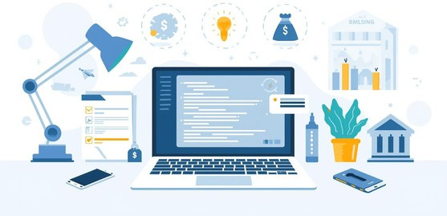

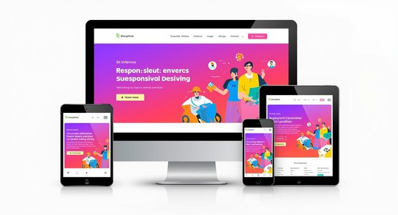
NLU Tools
Essential Technologies for Chatbot Development
Natural Language Understanding tools enable intent recognition.
Backend Frameworks
Robust frameworks support the chatbot's backend functionality.
Frontend Frameworks
Frontend frameworks create interactive user experiences effectively.

Slide 12
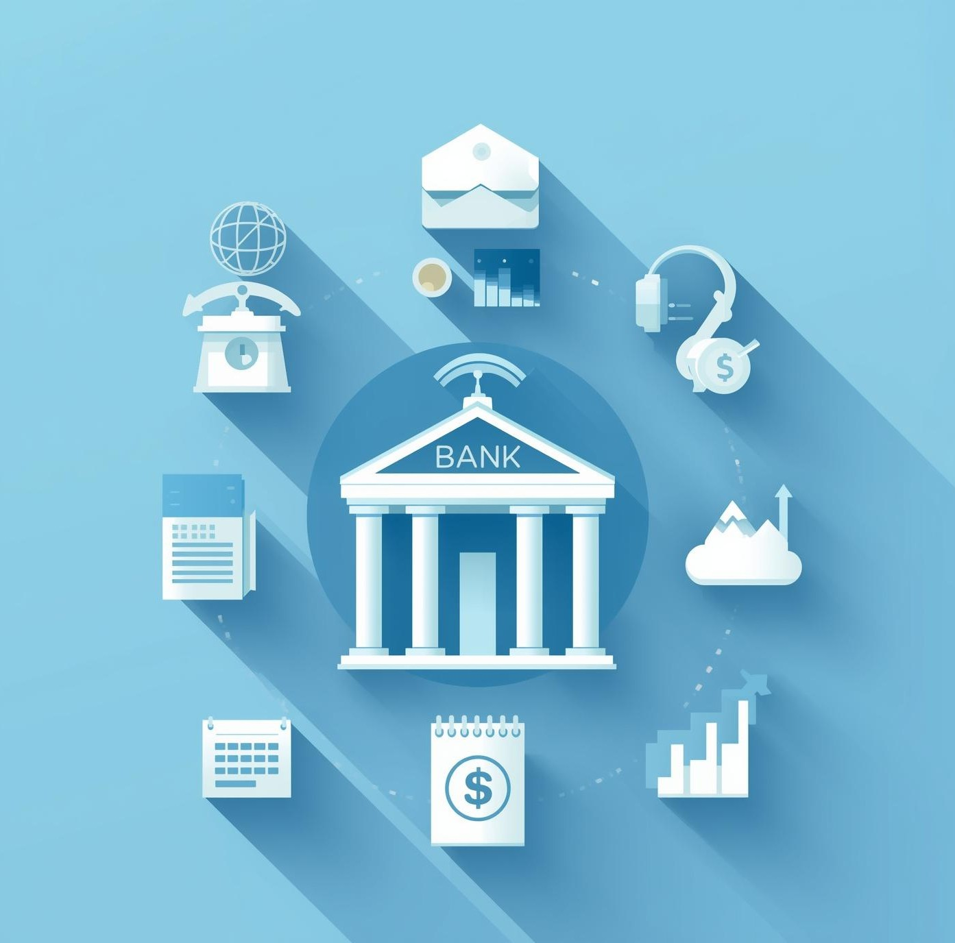
Thank You

